Slide 1
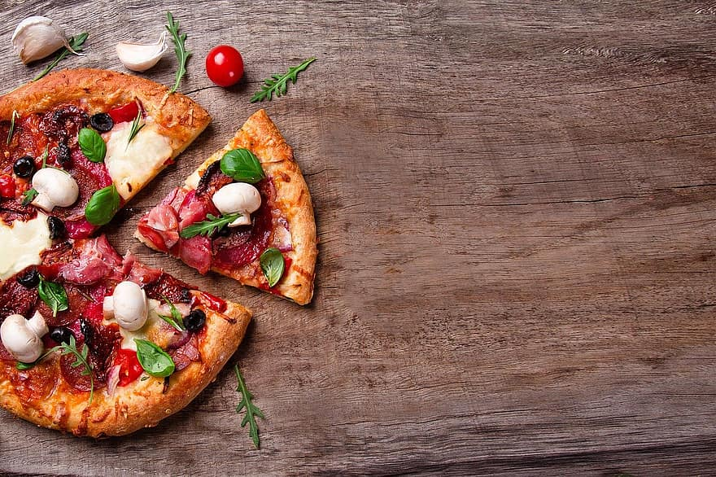
Pizza Place Sales Analytics Case Study
Project Owner - SAYANTAN NAHA

Slide 2
The Context & Objectives
Company
Context
Problem statement
Sales team of our company named Pizza Place gathered data on company sales throughout the year 2015 to analyse it for overall business profitability of the company.
The management of Pizza Place wants to improve overall sales of the company for the upcoming year of 2016. With that purpose, they asked the analytics department to analyse previous year’s sales data to make informed business decisions. They need a detailed report on this.
Find out how many customers do we have each day? Are there any peak hours?
How many pizzas are typically in an order? Do we have any bestsellers?
How much money did we make this year? Can we identify any seasonality in the sales?
Are there any pizzas we should take off the menu, or any promotions we could leverage?

Slide 3
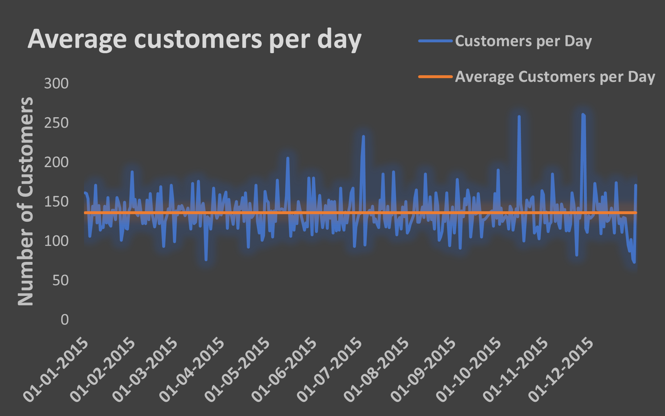
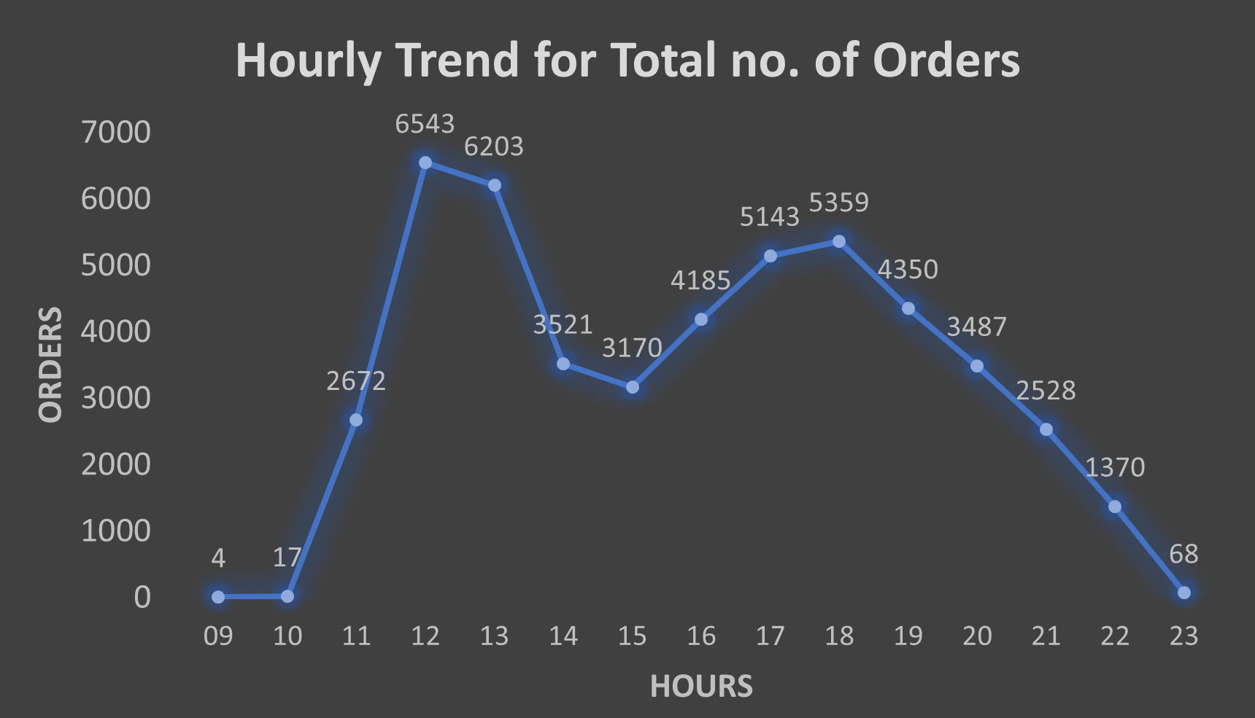
Analysis for Qs.1 - No. of customers/day & Hourly Trend for Orders
On average, 136 customers visit the pizza place joint per day

Slide 4
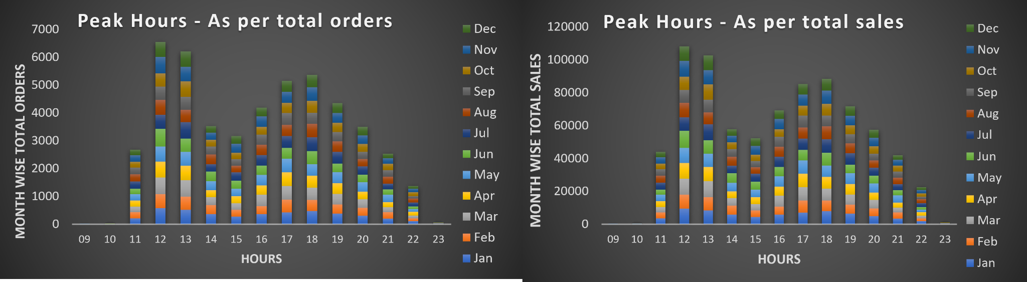
Analysis for Qs.1 contd. - Peak Hours of Sales
There are hours identified as peak time of business, giving most sales. Customers love to visit the pizza place on that time
12pm to 1pm at afternoon time
5pm to 6pm at evening time

Slide 5
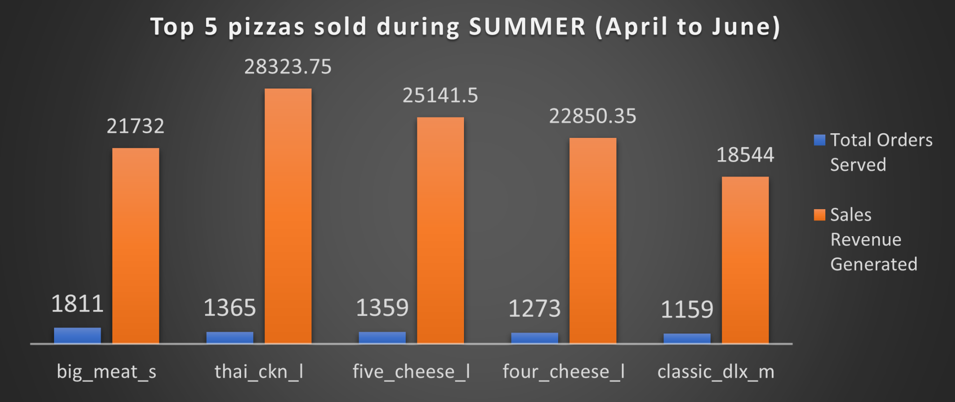
Analysis for Qs.2 - How Many Pizzas/order & Bestseller Pizzas
On average 2 pizzas were sold per order
We found 2 pizzas as bestsellers
In terms of number of orders & total quantity served, big_meat_s or the big meat pizza of small size falling under the classic category
In terms of sales revenue generation, thai_ckn_l or the thai chicken pizza of large size falling under the chicken category

Slide 6
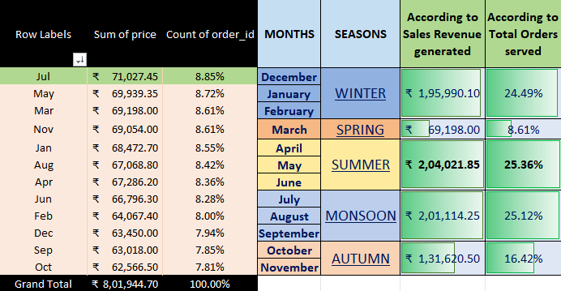
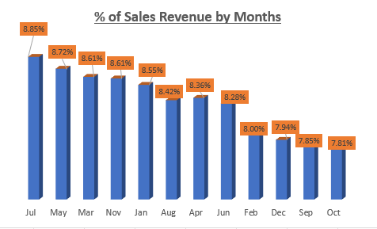
Analysis for Qs.3 - How Much Sales Revenue in 2015 & Seasonality in Sales
In 2015, for the whole year, the pizza place joint has made a total sales revenue of INR 8,01,944.70
In 2015, the months of April to June (3 months) were the highest selling months, when the most of the sales happened, a total of INR 2,04,021.85 revenue generated from sales, 25.36% of total sales in 2015. In India, this is the Summer season.

Slide 7
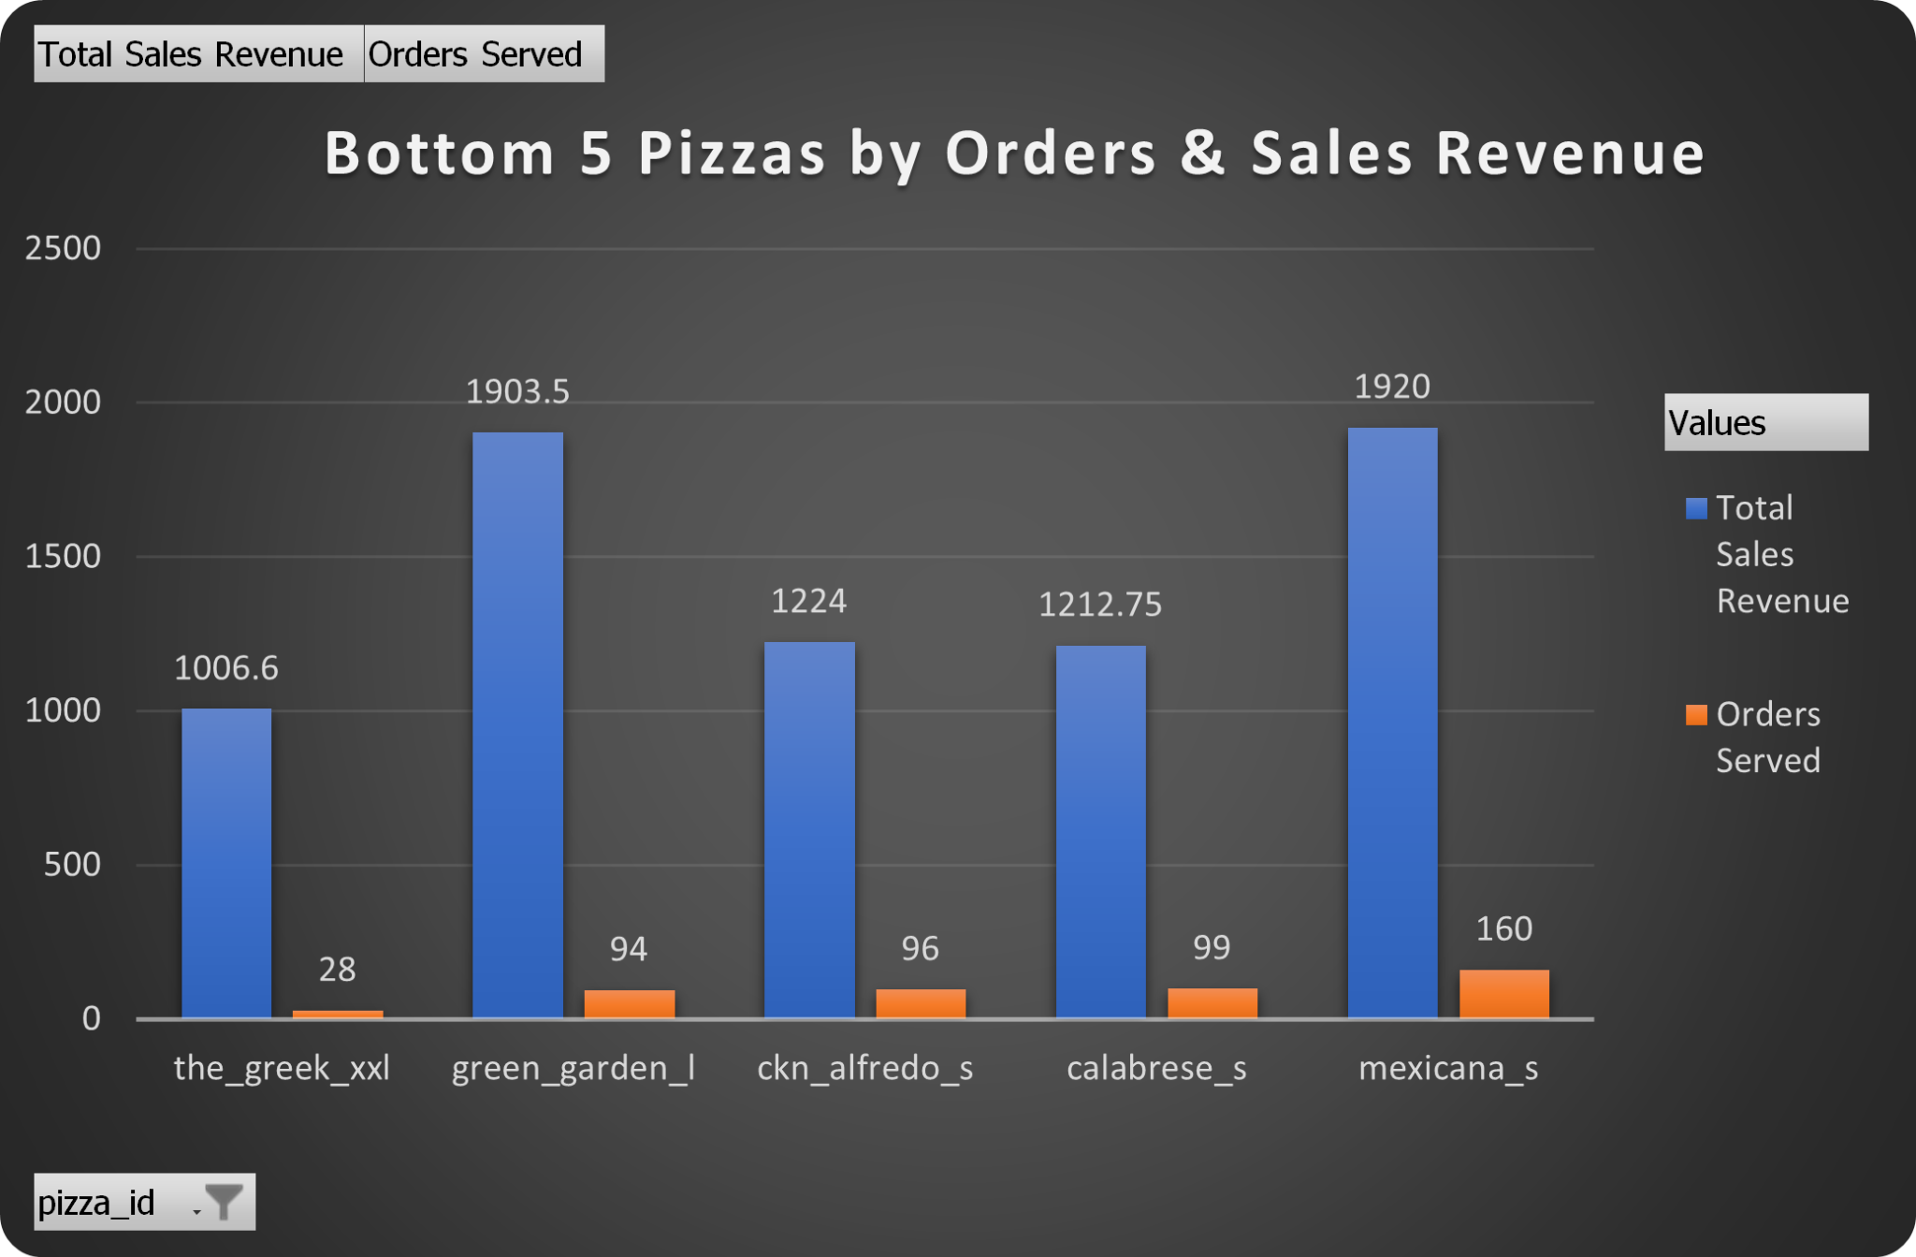
Analysis for Qs.4 - Menu optimization & Leveraging Promotional Discount Offer
We should take off the_greek_xxl (The Greek Pizza) from the menu. Reason behind this decision is due to the lowest sales revenue generated (INR 1006.6) and also the lowest number of orders (only 28) served with this pizza item.
One business strategy we can make is to simply provide promotional discounts for the lowest selling pizzas. Also, we can introduce a buy-one-get-one offer during the SUMMER season, when any of the highest selling pizzas are sold, one lowest selling pizza of our choice is offered at no cost or at discounted rate.

Slide 8
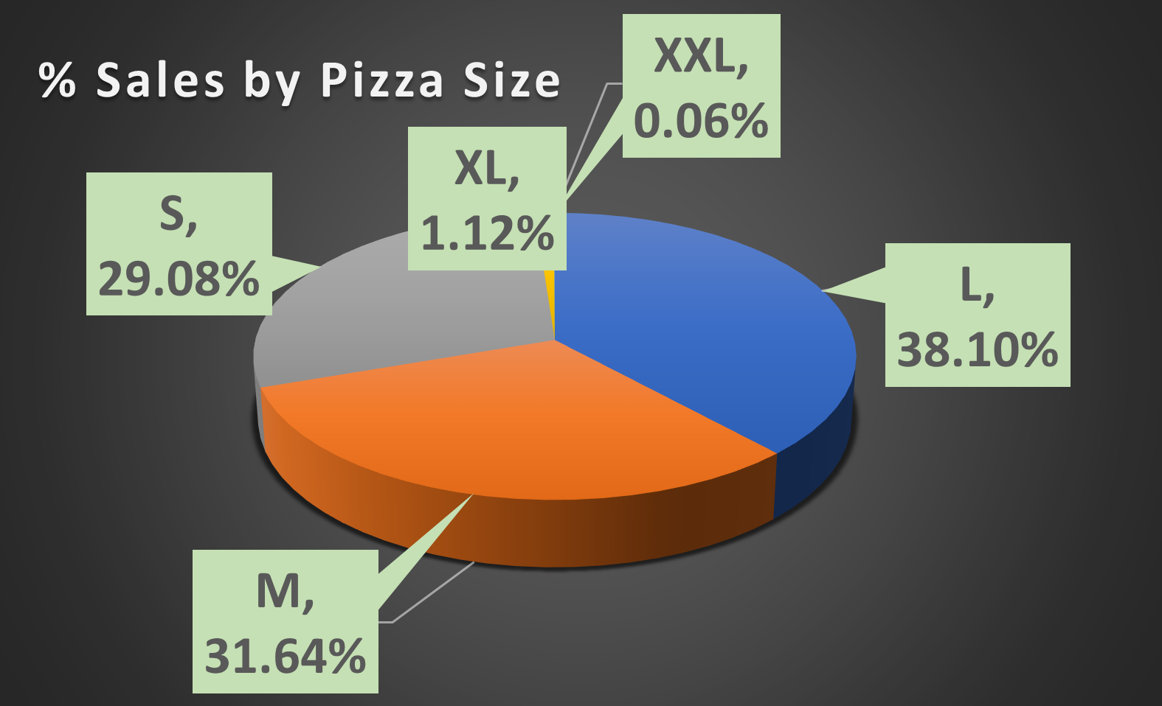
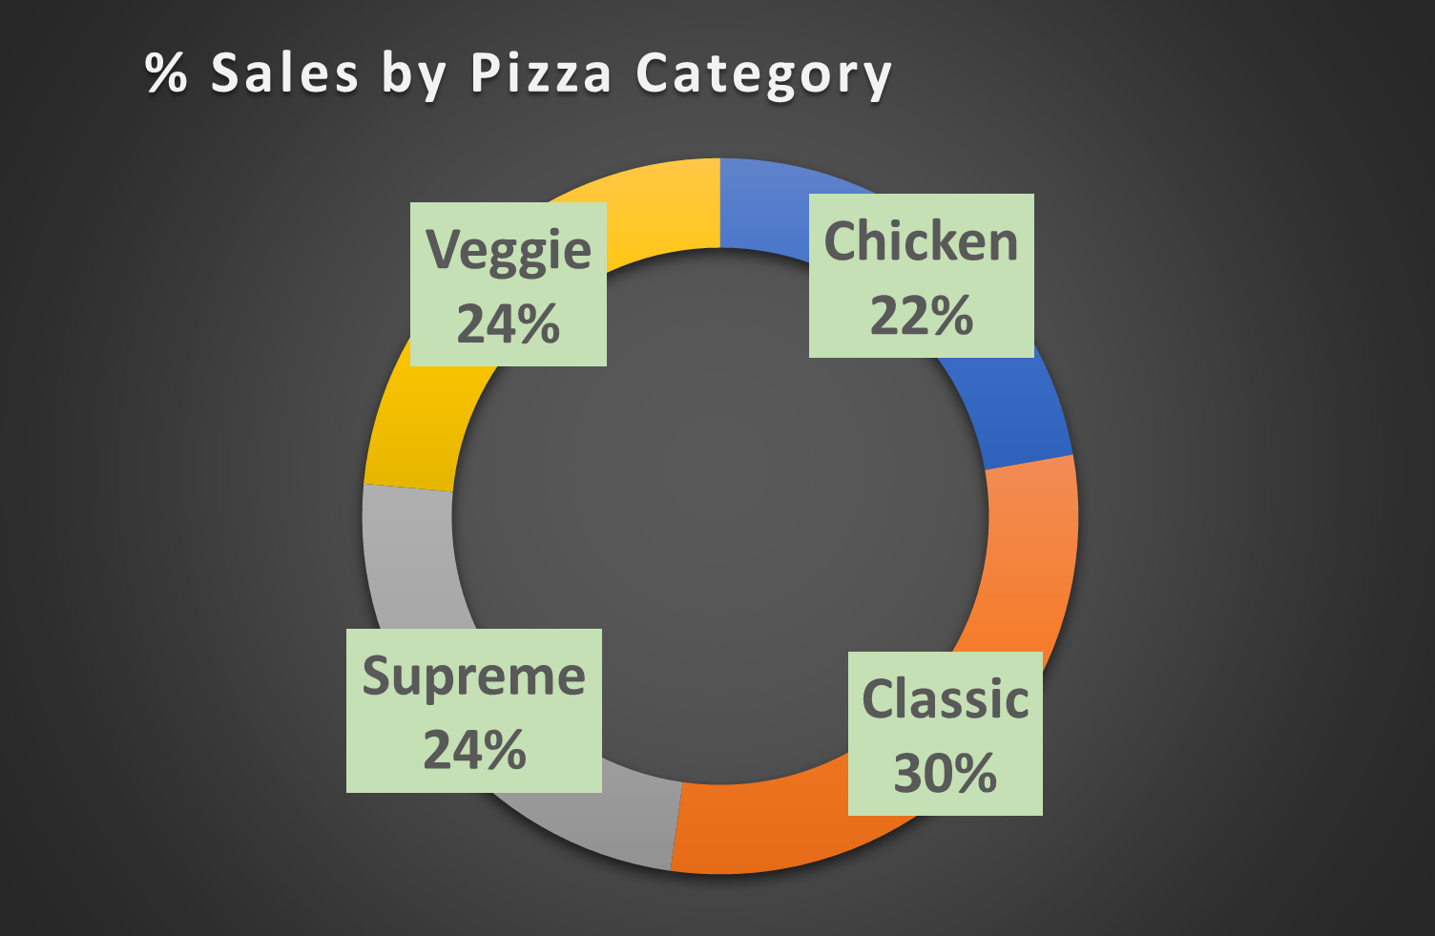
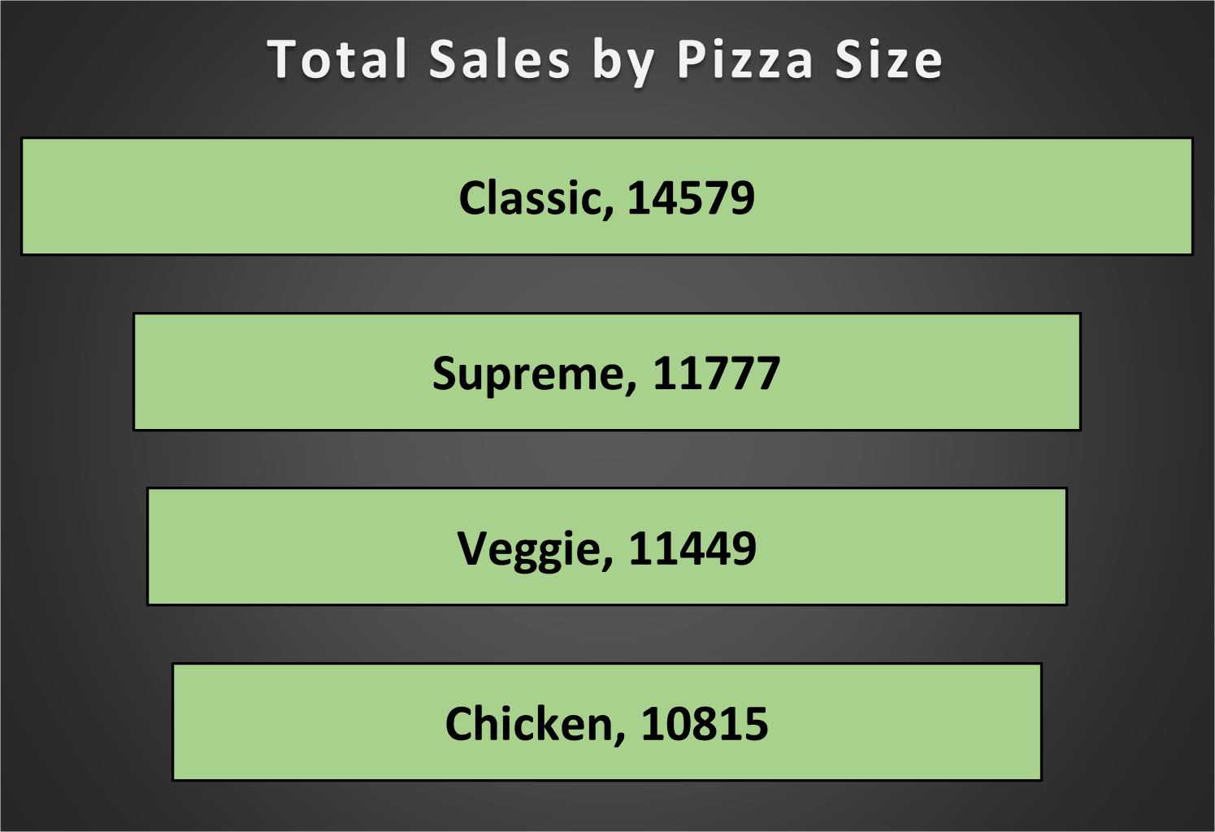
More Insights

Slide 9
Impact
After the significant amount of analysis is done, we found some related Key Performance Indicators (KPIs) that must have a positive impact on business performance of Pizza Place.
Daily customer count, on average
Average pizza count per order
Peak hours of 2015 business
Bestseller pizzas
Peak season of business in 2015
Sales revenue generated for the whole year & for the peak season
By identifying patterns and trends in pizza sales, it will be much easier for the management to take data-driven informed business decisions. Management can re-design the menu offerings and leverage promotional strategies to achieve more revenue from business & improve customer service in the upcoming year for sure.
max growth

Slide 10
THANK YOU
Do you have any questions?
Feel free to connect
sayantanpiku18@gmail.com

